Slide 1
Hardware Refresh
In almost all cases, hardware that is five years old is too constrained and inflexible to meet today’s user demands. The goal is to determine asset age and refresh old hardware in our current environment.

Slide 2
Top 5 reasons to refresh:
It costs less than upgrading old hardware.
Enables us to keep up with business demands easily.
Improves application performance.
Supports more workloads.
Better positioned to achieve business goals.

Slide 3
Why refresh now?
The latest technology is more powerful, flexible and scalable.
Potential annual savings of millions of dollars in capital and operational costs.
Enables us to stop paying annual warranty or maintenance fees to vendors on older hardware.

Slide 4
Pre-work:
Gather information about the assets.
Serial number
Model number
Purchase date
Warranty information
Location

Slide 5
Where did I get my information:
Spreadsheets
Purchase orders
Hubble
Splunk
Syslogs
Other internal asset management tools

Slide 6
Process:
Evaluate the data that was gathered.
Remove duplicate values and unnecessary information.
Verify the information is valid.
Sort the data by purchase date to verify asset age.
Run a count of how many assets are aged over 5 years.
Create graph to display the data.

Slide 7
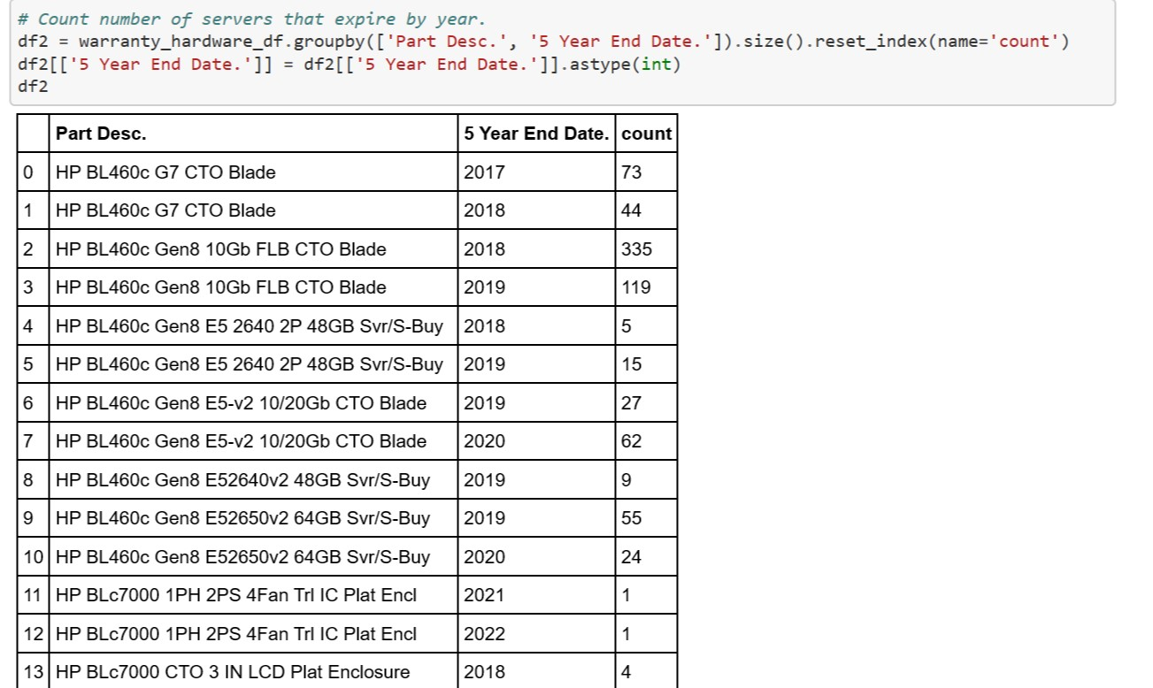
Count number of servers that expire by year

Slide 8
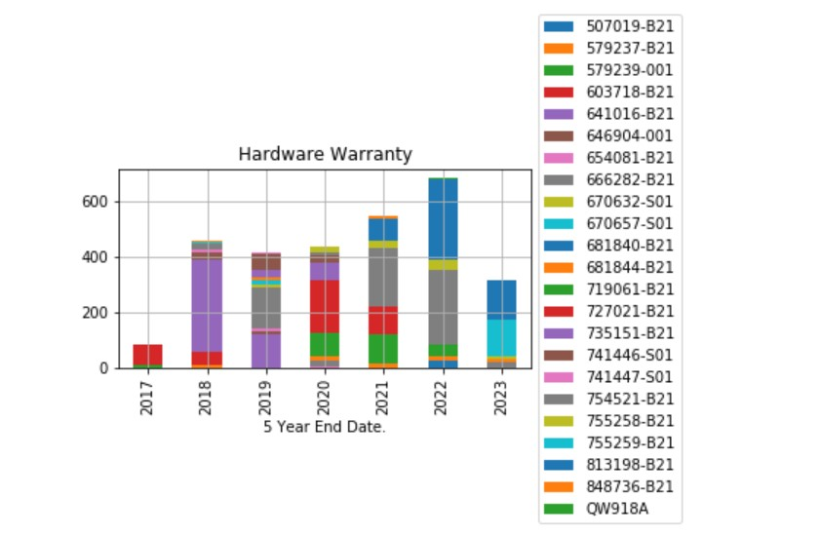
Hardware – Representation

Slide 9
Conclusion
Based on the data that I gathered I confirmed there are assets in our environment that need to be refreshed.
My data shows how many assets have aged at least 5 years.
The biggest challenge that I found was a lot of discrepancies with the warranty dates which required additional validation.
Final result
Identified the assets that have aged over 5 years and have created an action plan to have them refreshed.

